Slide 1











TURTLE GRAPHICS IN PYTHON

Slide 2

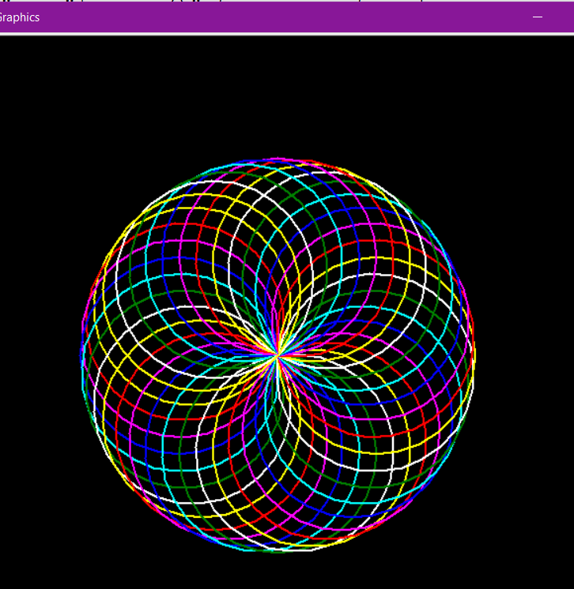
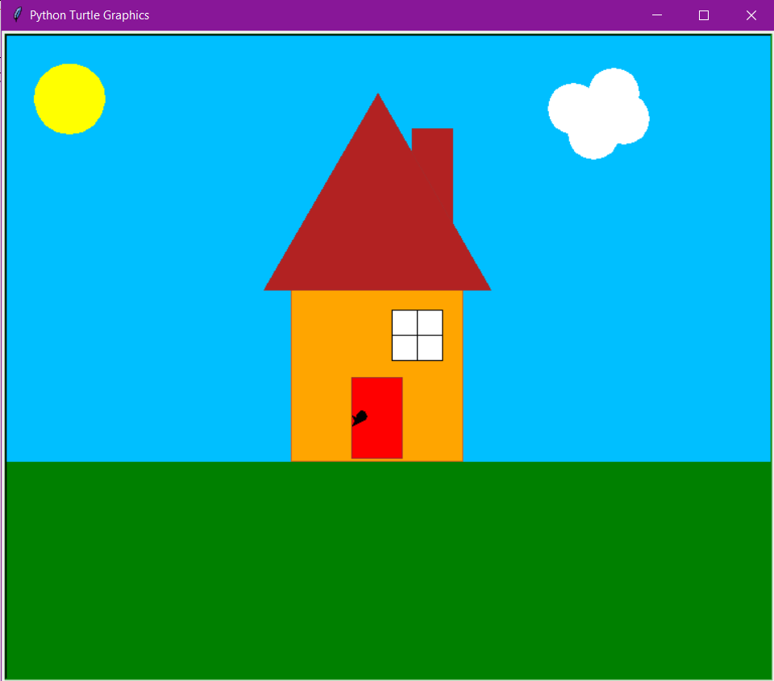
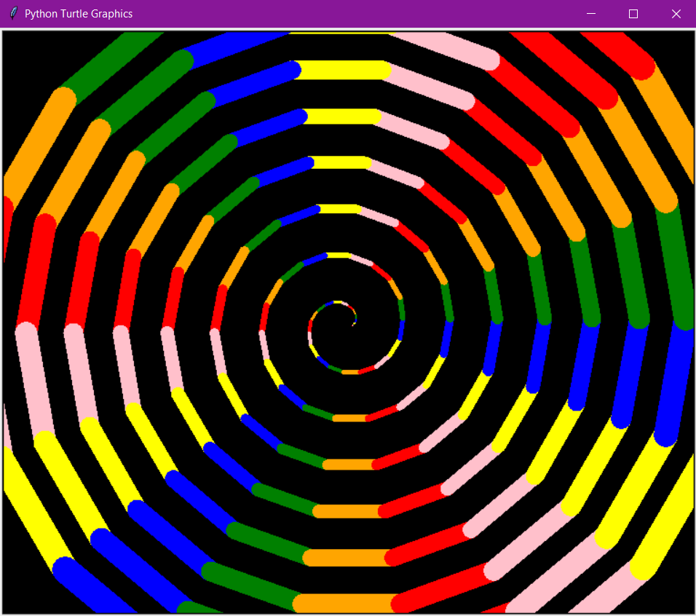
DRAW WITH TURTLE

Slide 3
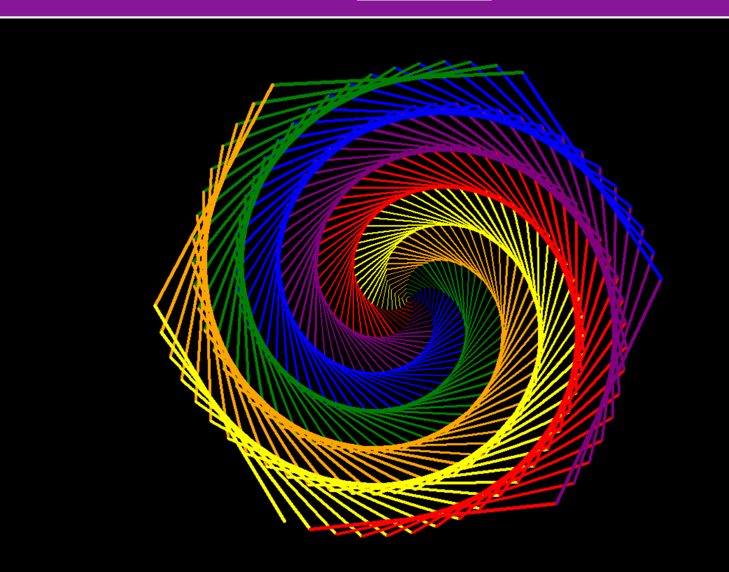
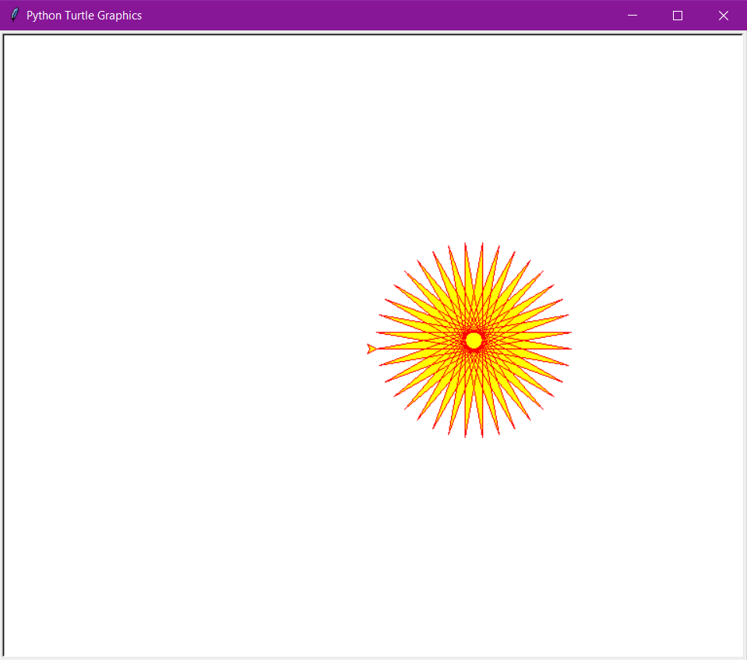
DRAW WITH TURTLE

Slide 4






TURTLE GRAPHICS
To enable scripting mode for Turtle in Python IDLE, follow the below mentioned instructions:
(Follow the instructions and run the codes attached in Mail)

Slide 5


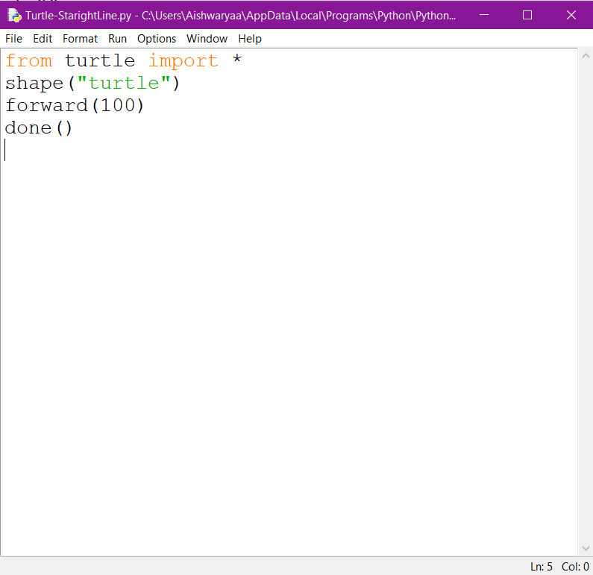
STEP 1
Open the file attached in Mail.

Slide 6
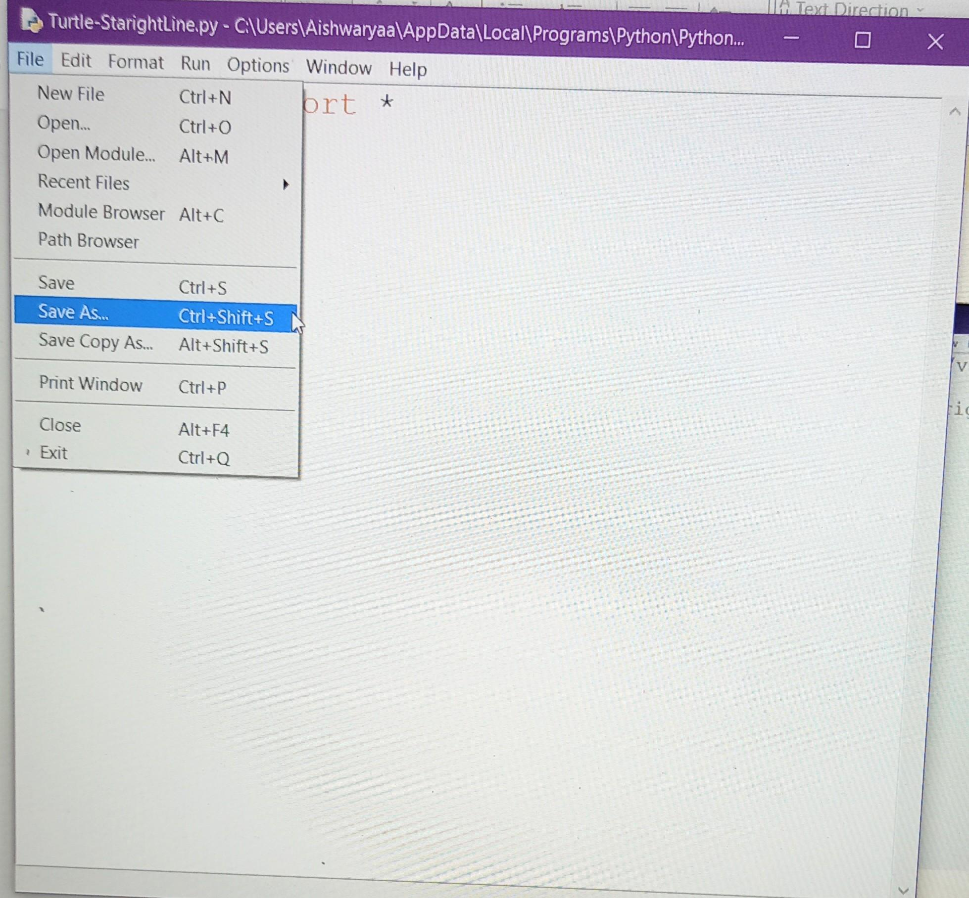
STEP 2
Click on File and then Save As.

Slide 7
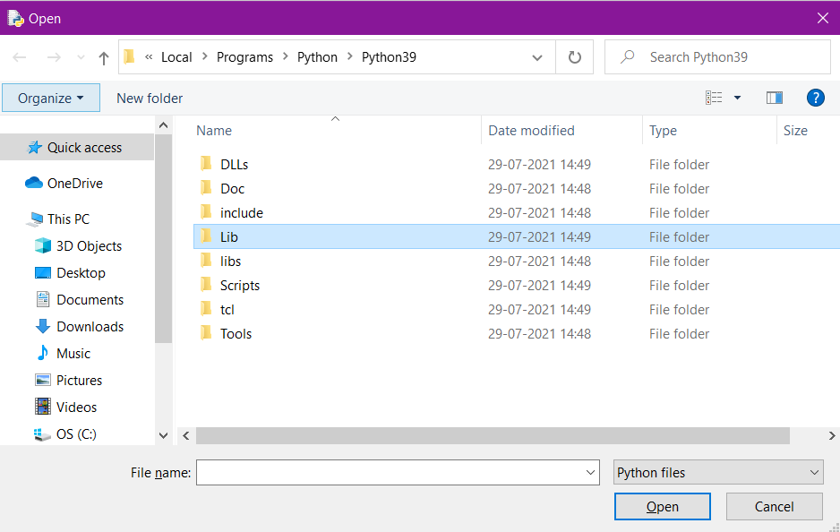
STEP 3
A new window will appear.
Go to Lib.

Slide 8
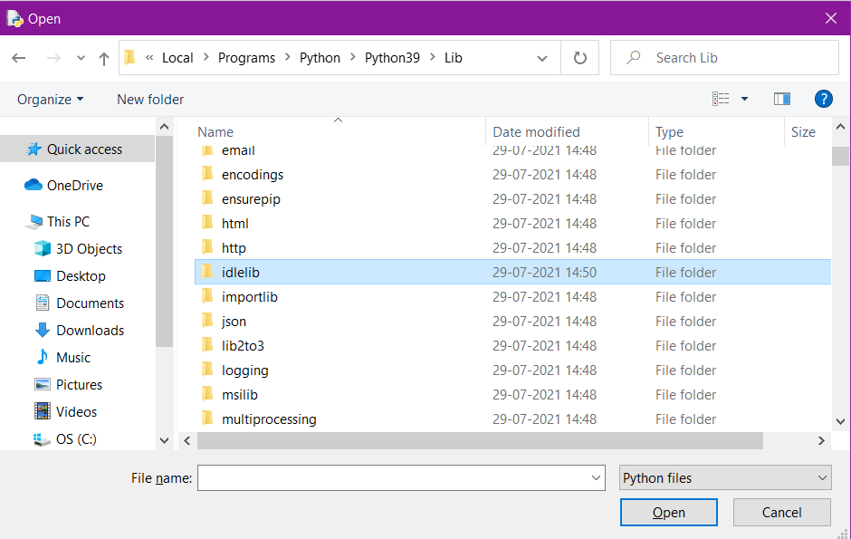
STEP 4
Inside Lib, go to idlelib.

Slide 9
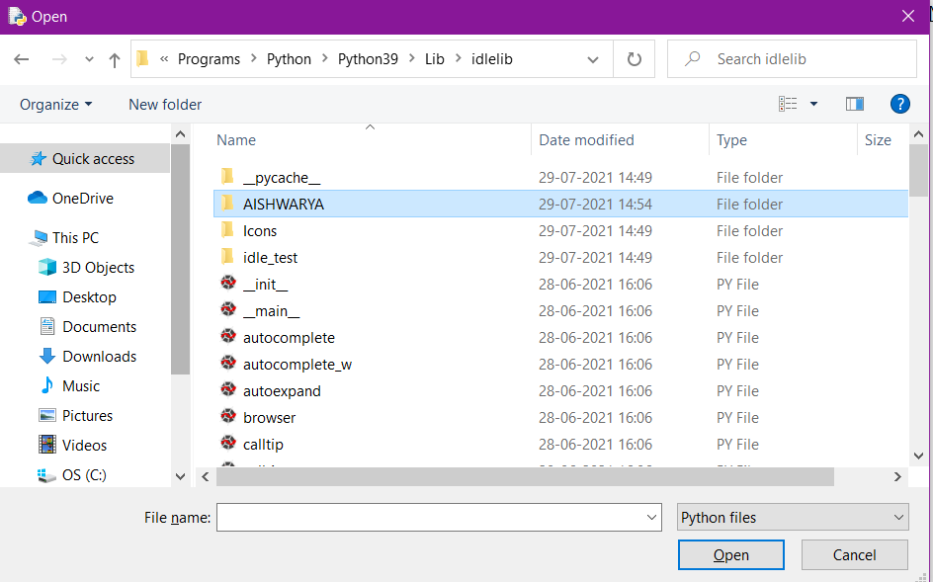
STEP 5
Inside idlelib, create a folder by your name.

Slide 10
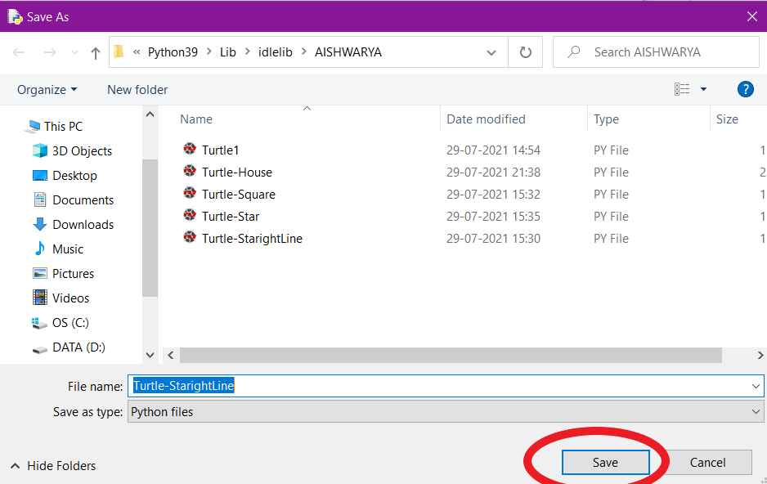
STEP 6
Click on Save to save your file inside the folder.

Slide 11
YOU HAVE SAVED YOUR FILE SUCCESSFULLY!!

Slide 12
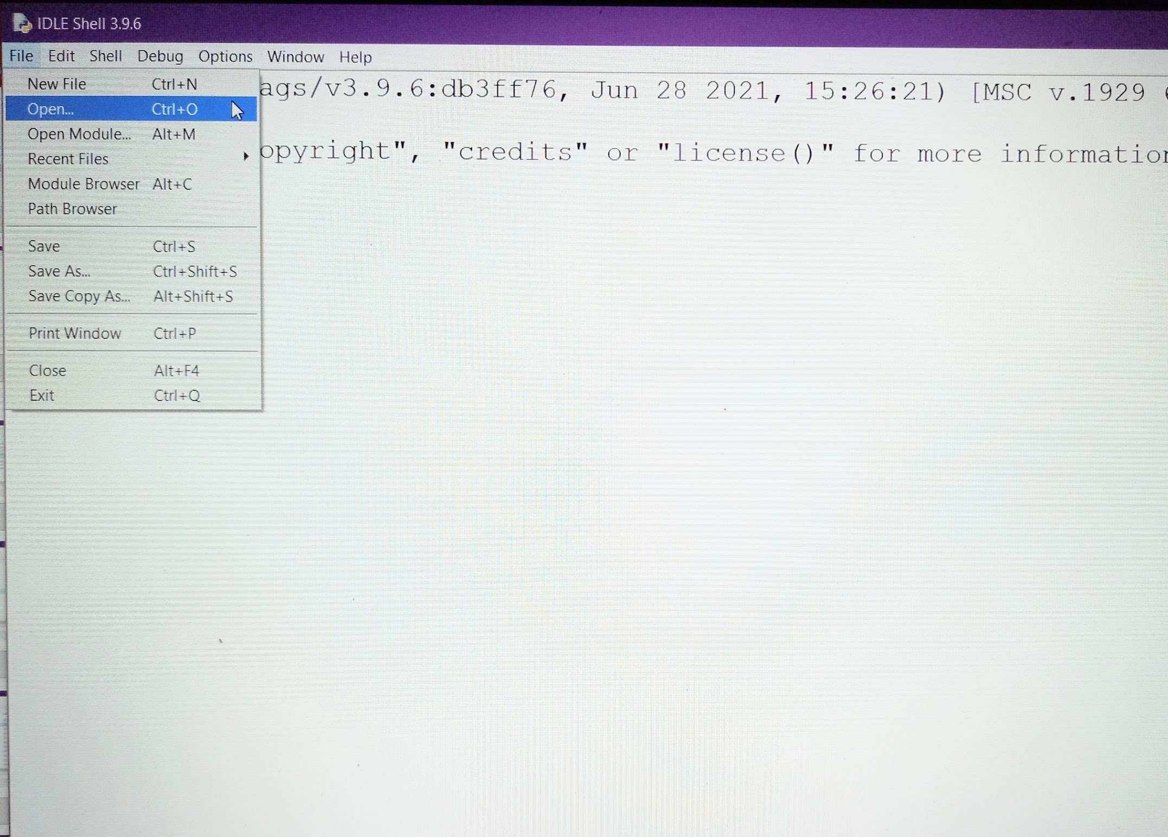
TO OPEN
YOUR FILE
Open Python IDLE and click on Open.

Slide 13
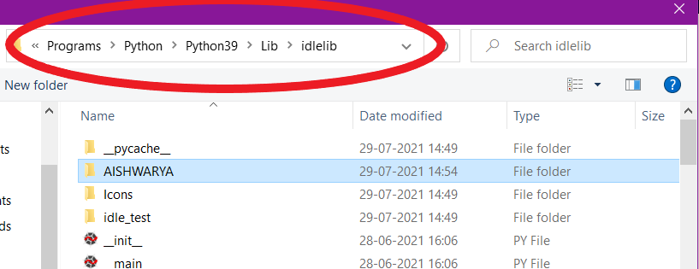
Follow the same path:
Lib > idlelib > AISHWARYA

Slide 14
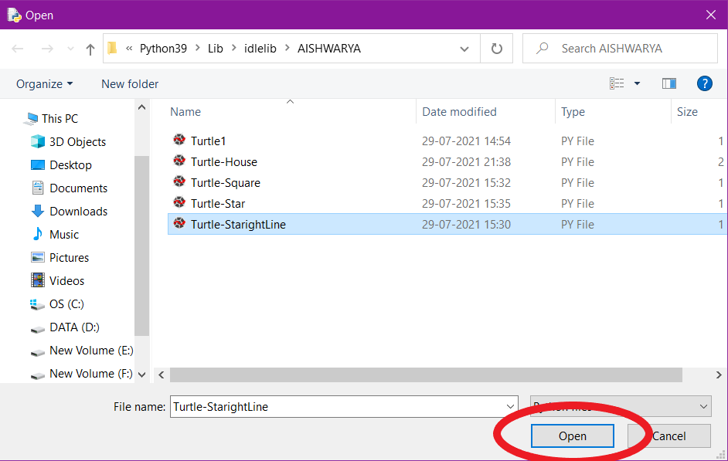
Click on the file you want to open and then click on Open.

Slide 15
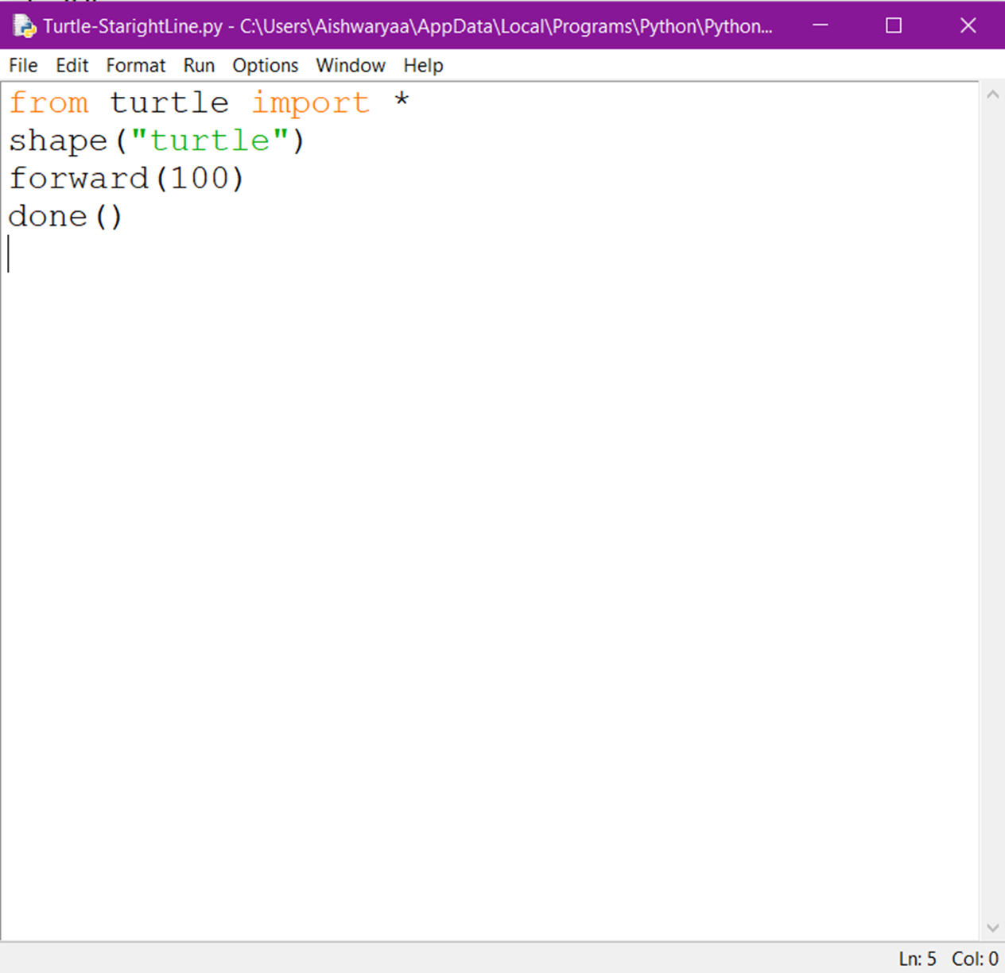
YOU HAVE opened YOUR FILE!!

Slide 16
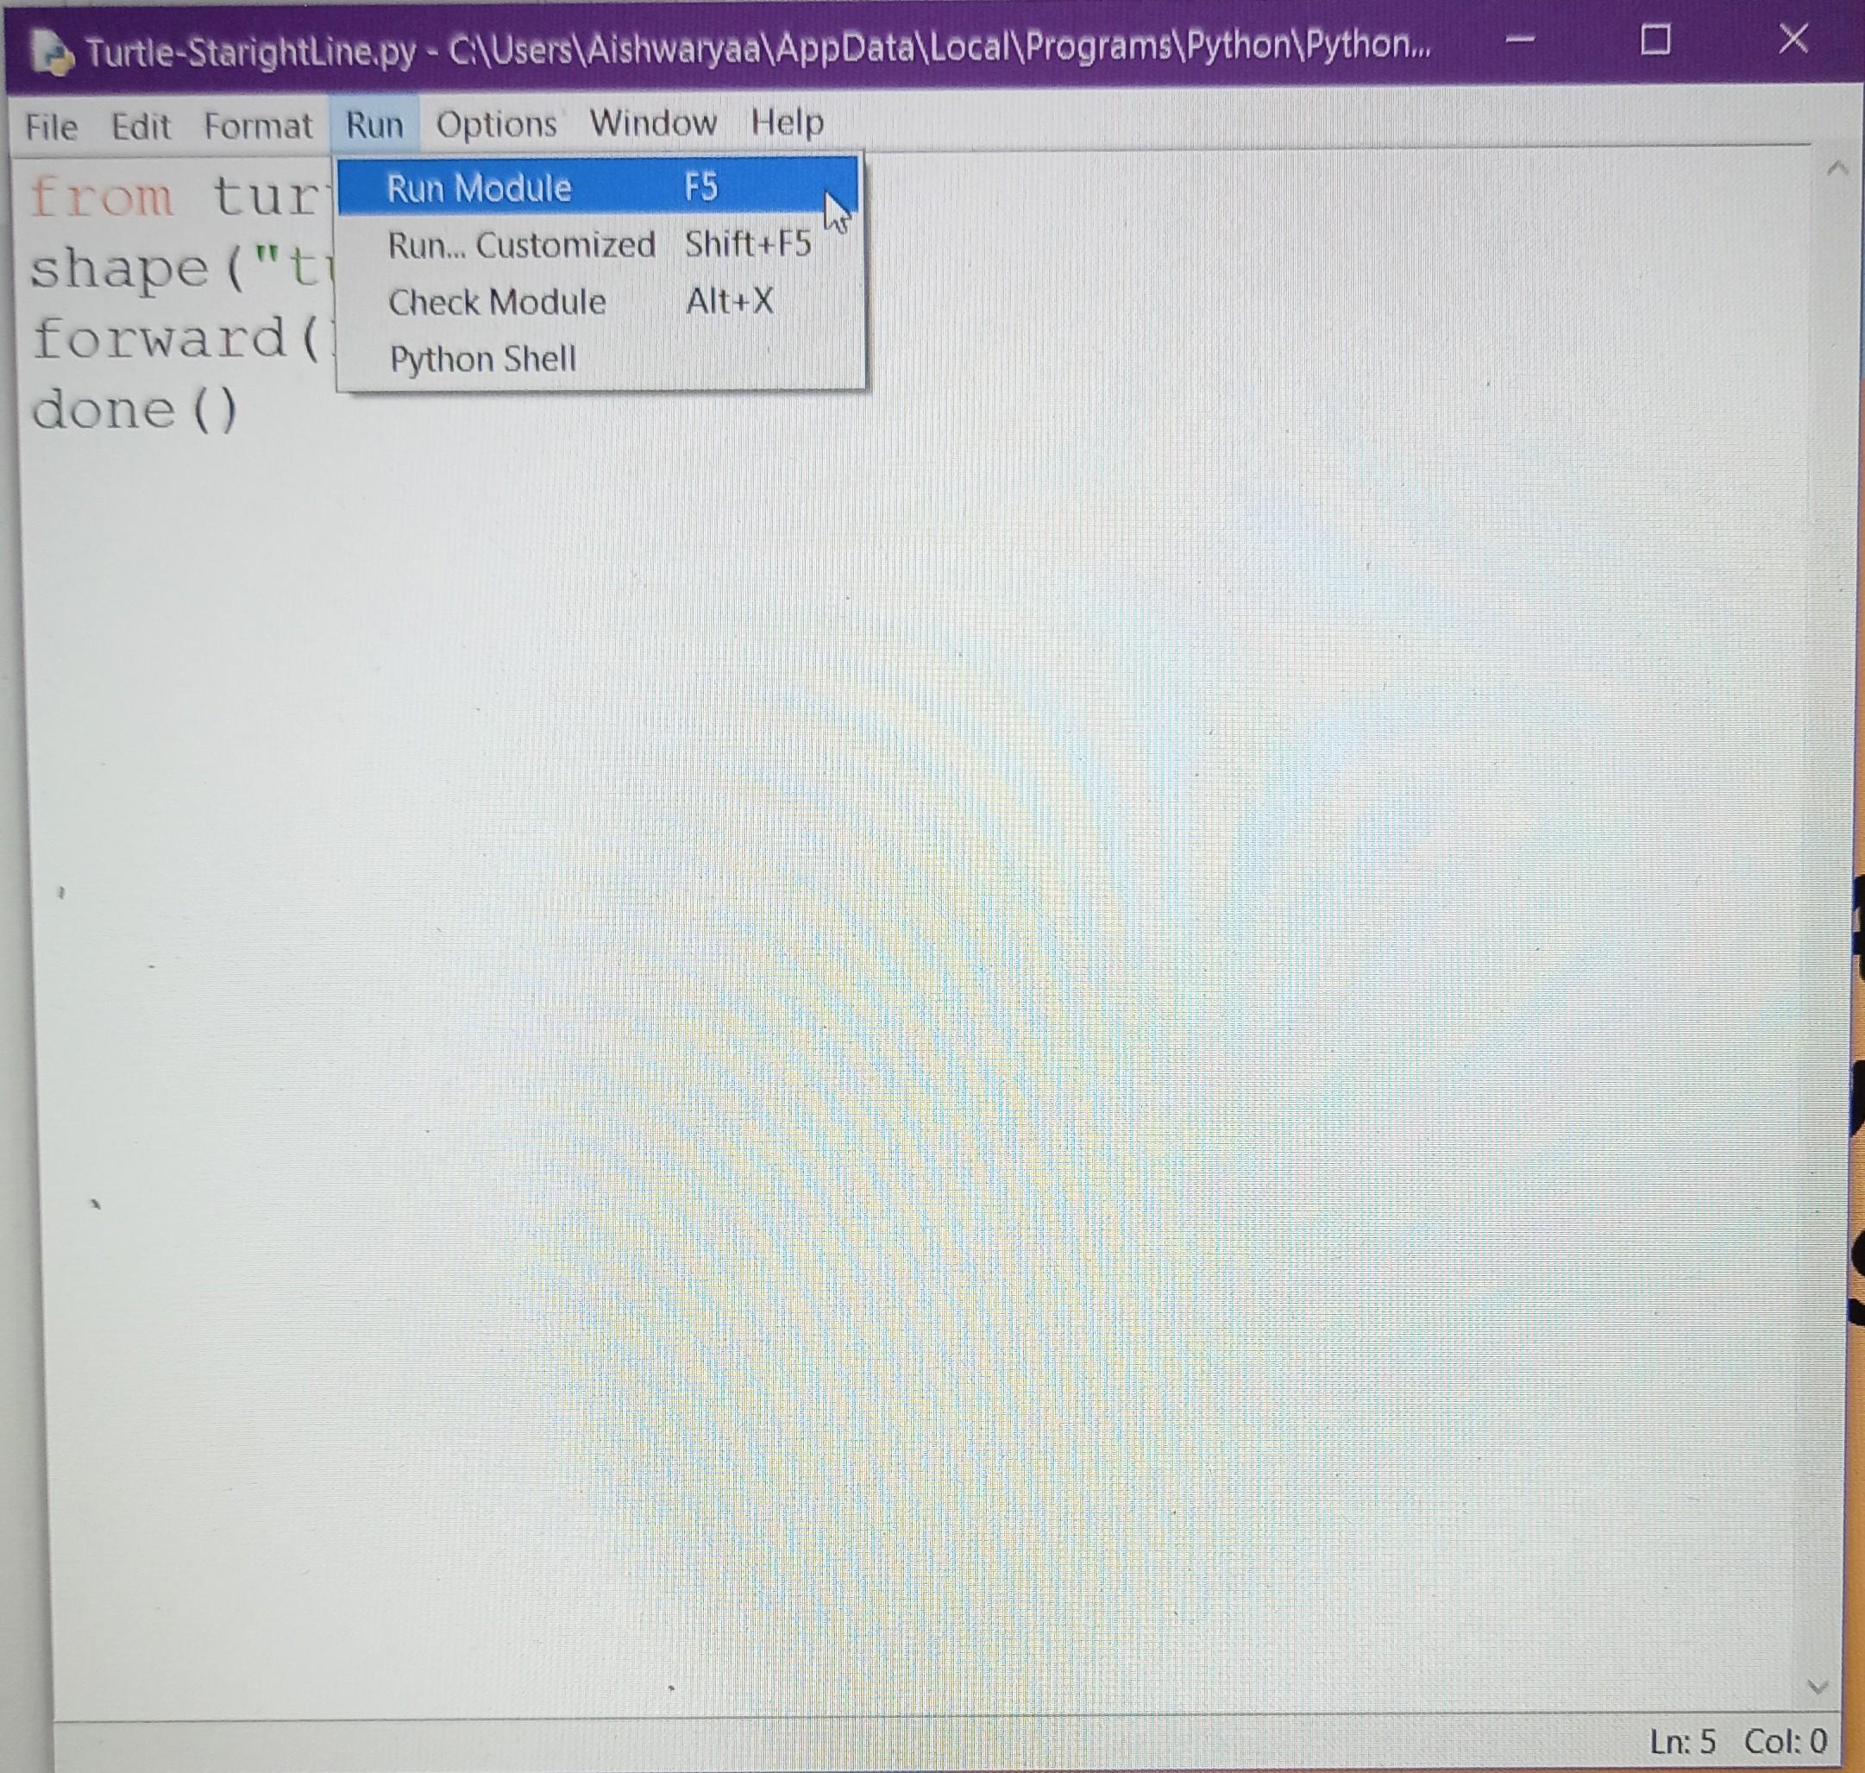
TO RUN
YOUR FILE
Click on Run and then Run Module.

Slide 17
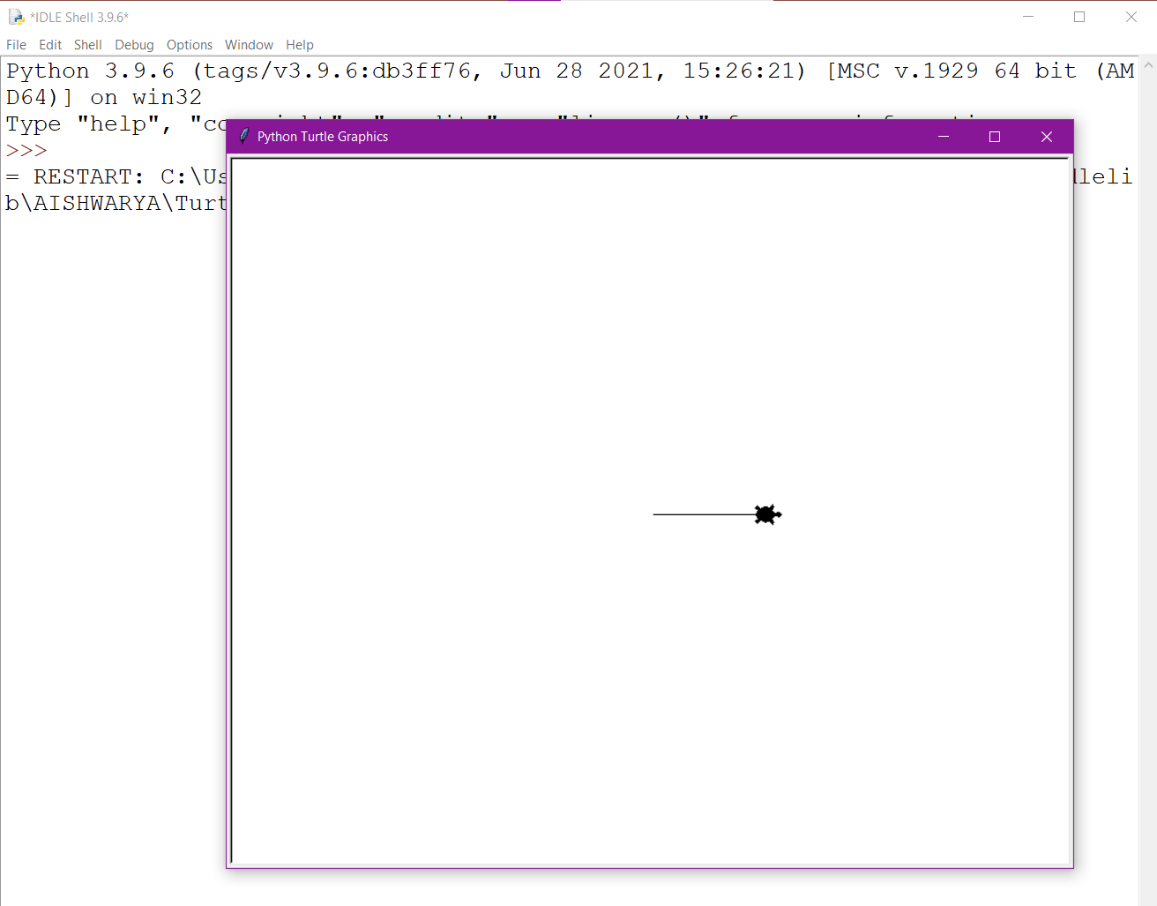
RUN YOUR FILE and see the output for yourself!!

Slide 18


HAPPY LEARNING!

